Slide 1
Project 4.1
Project –Machine Learning In Disease Prediction

Slide 2
Introduction
Disease prediction has long been regarded as a critical topic. With big data and Machine. Learning growth in biomedical and healthcare communities, accurate analysis of medical data benefits early disease detection, patient care, and community services.

Slide 3
Objective
Build Machine Learning Models to predict the type of Breast Cancer (Malignant or Benign) as well as identify the drivers of cancer.

Slide 4

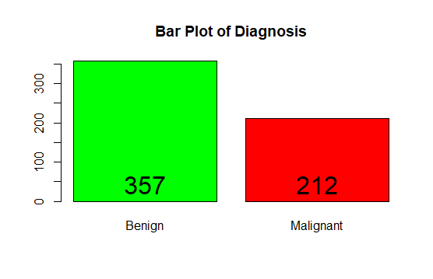

Initial Count of Benign and Malignant

Slide 5
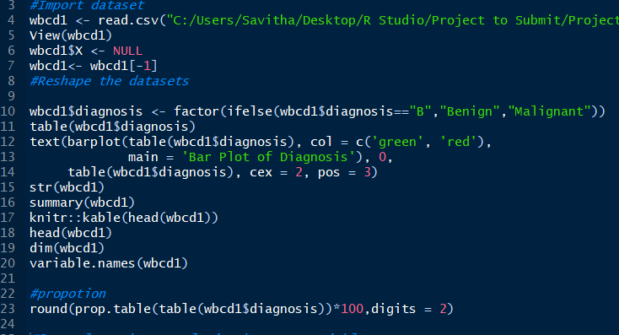
Exploring features and Data Preparation which includes missing value treatment and Outlier Detection

Slide 6
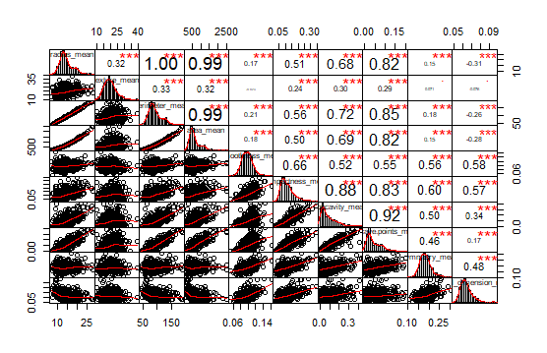
Correlation between each variables

Slide 7
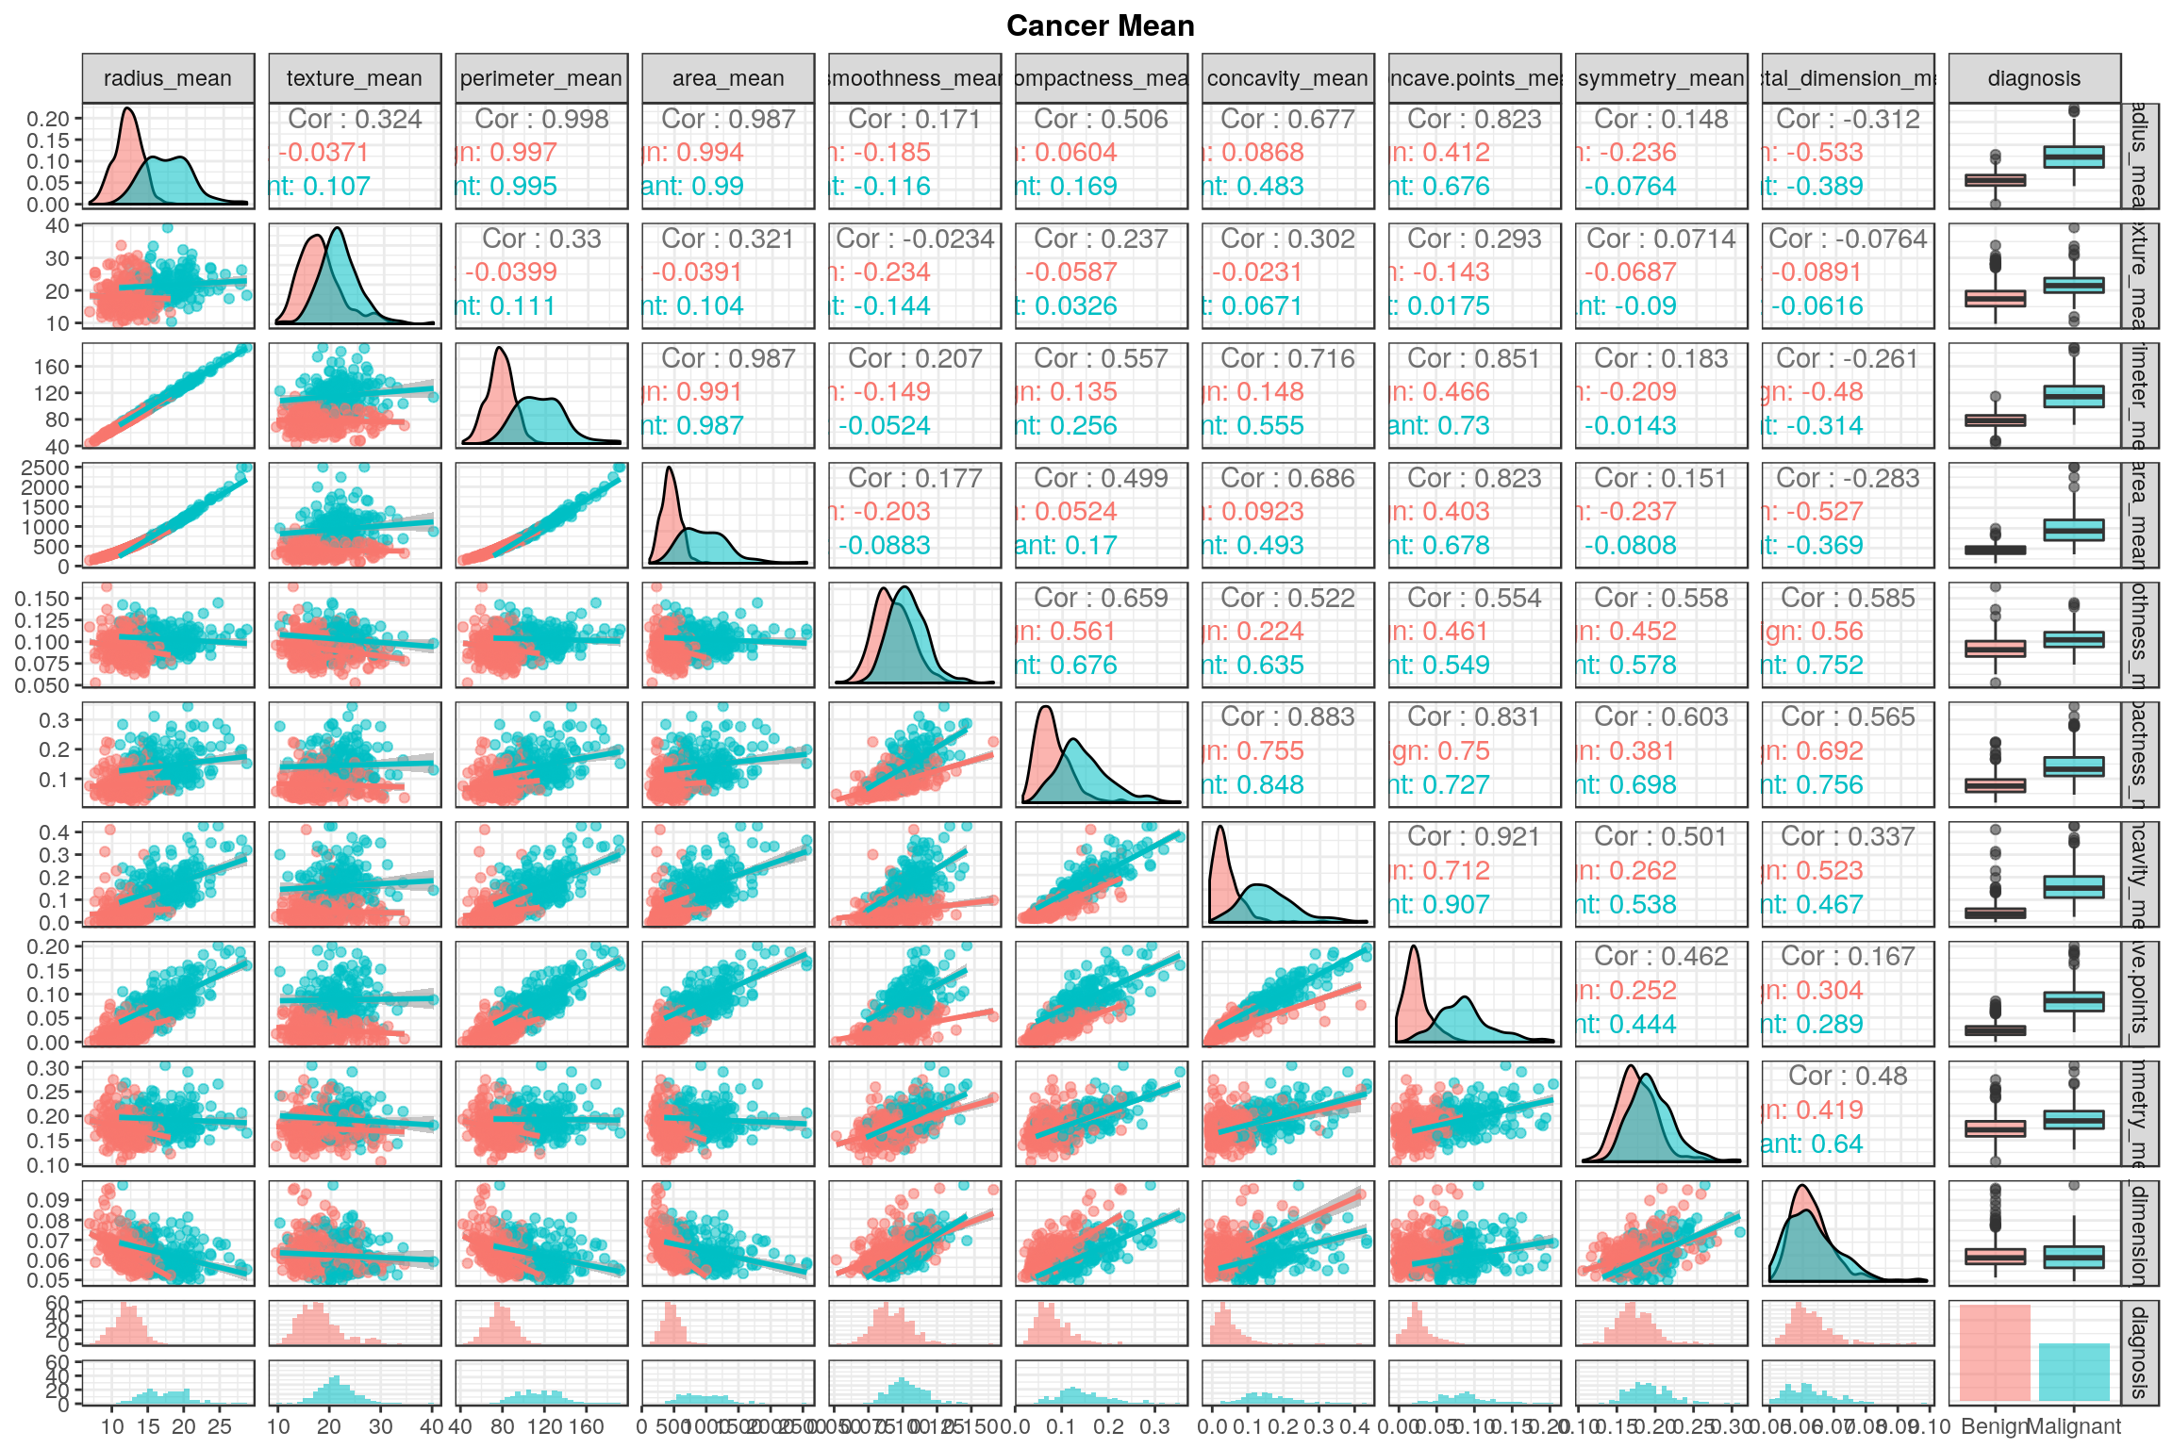
Relation between each variables (diagnosis included)

Slide 8
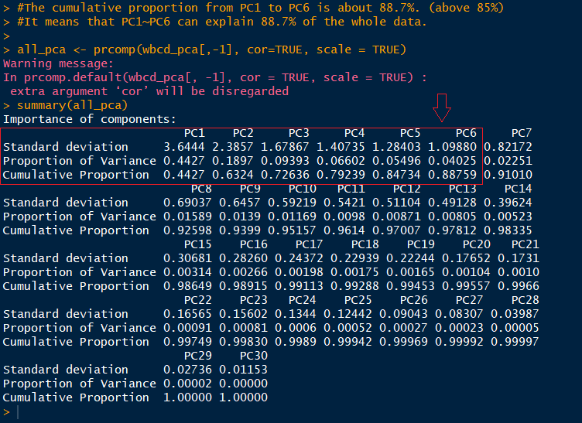
Principal Component Analysis

Slide 9
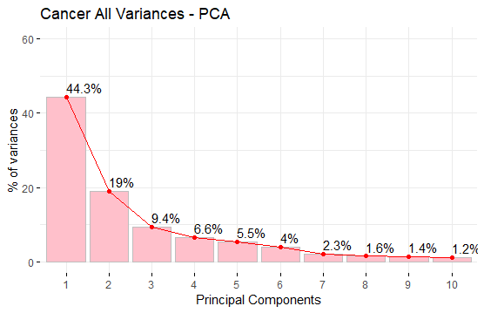
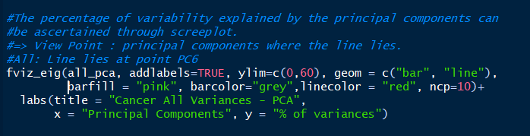
Principal Component Analysis - Line lies at point PC6

Slide 10
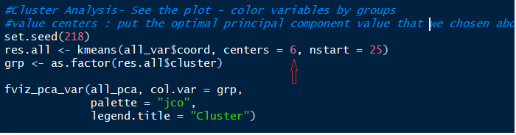
Cluster analysis to see the influence of variables

Slide 11
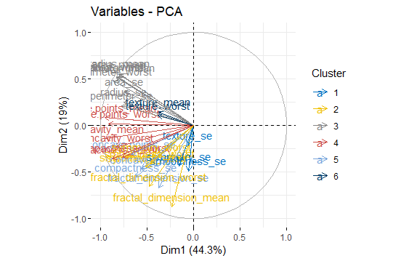
Cluster analysis-Determining the factors driving the cancer.

Slide 12
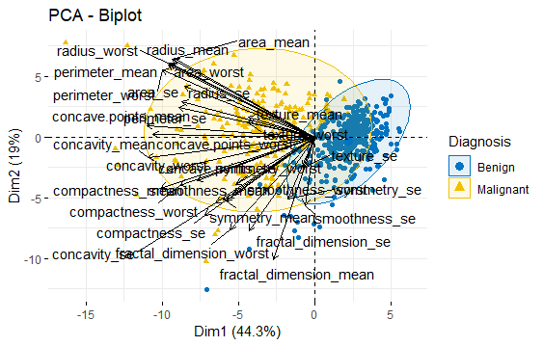
Cluster analysis- PCA Biplot showing the variable effect

Slide 13
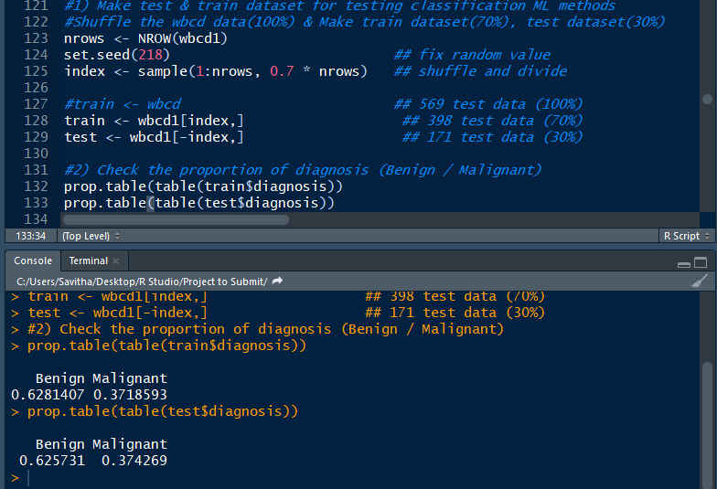
Creating Test & Training Data

Slide 14
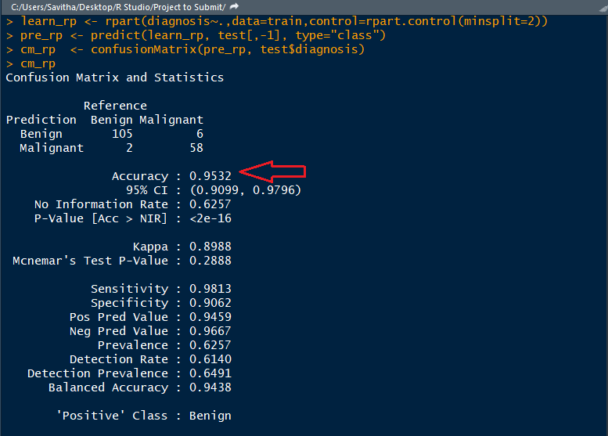
Applying Model - R Part

Slide 15
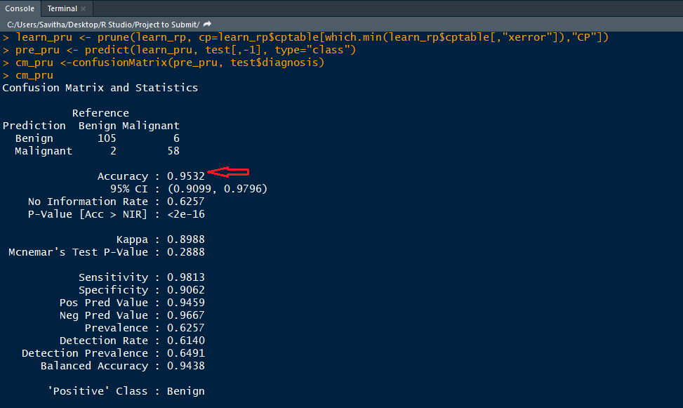
Applying Model - Prune

Slide 16
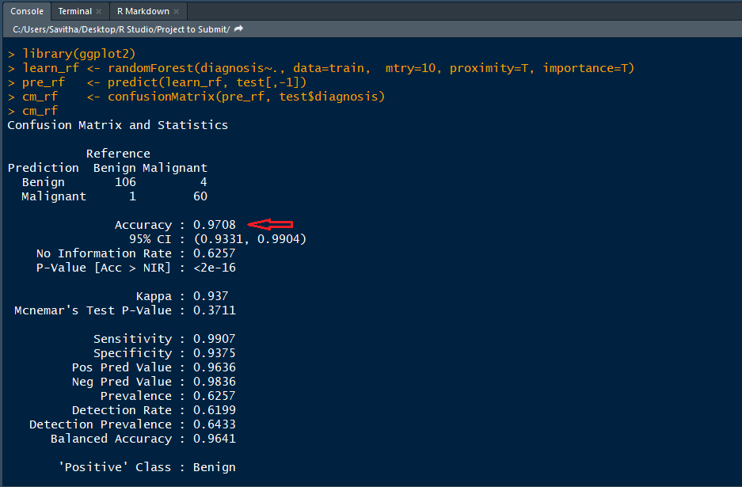
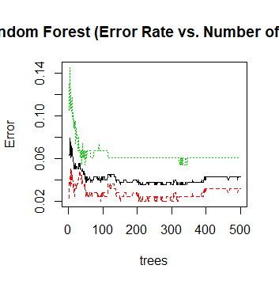
Applying Model - Random Forest

Slide 17
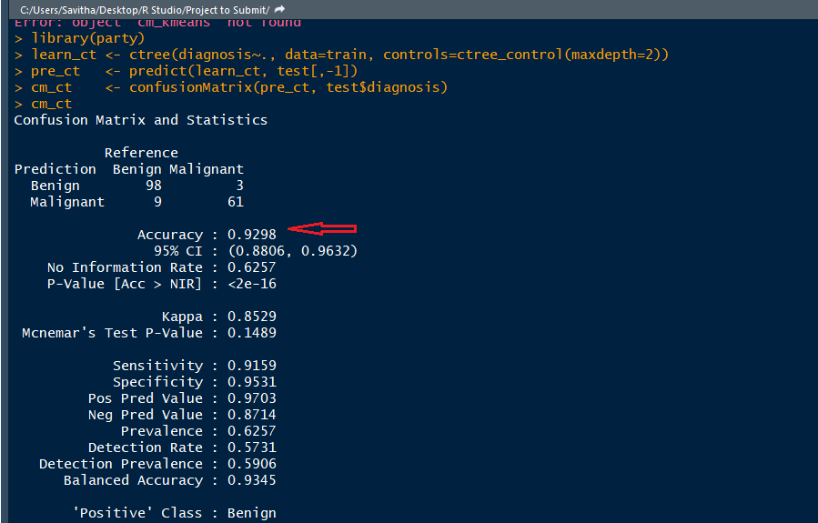
Applying Model - ctree

Slide 18
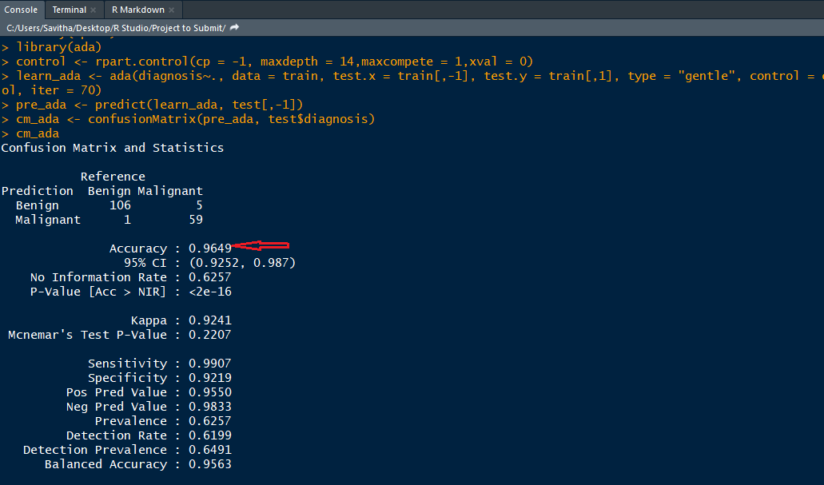
Applying Model - Adaptive boosting code

Slide 19
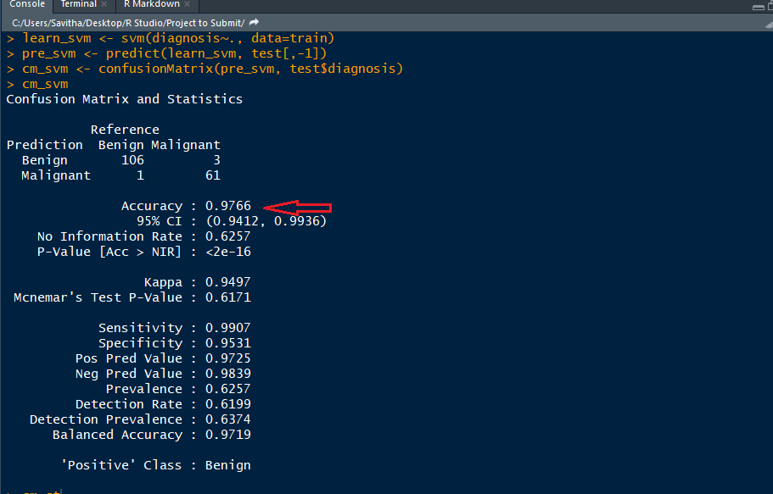
Applying Model - Support Vector Machine

Slide 20
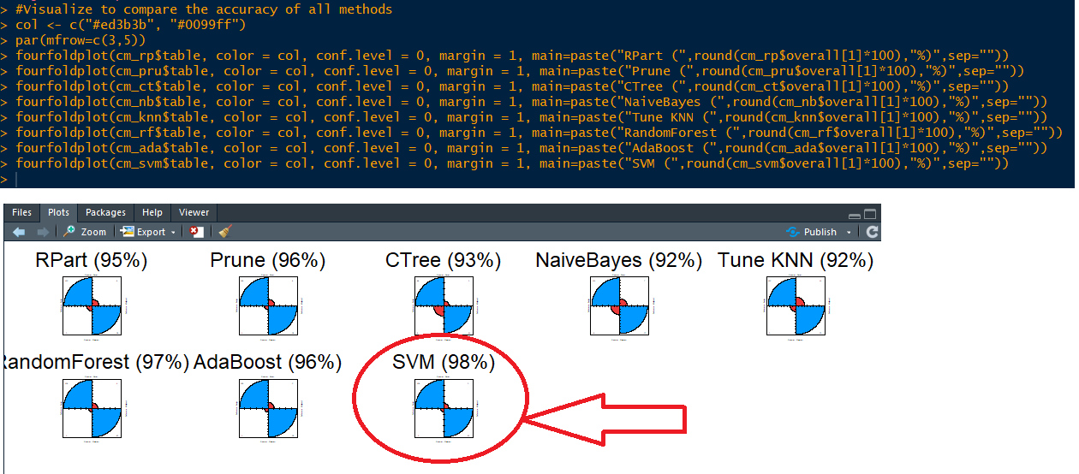
Visualize to compare the accuracy of all methods

Slide 21
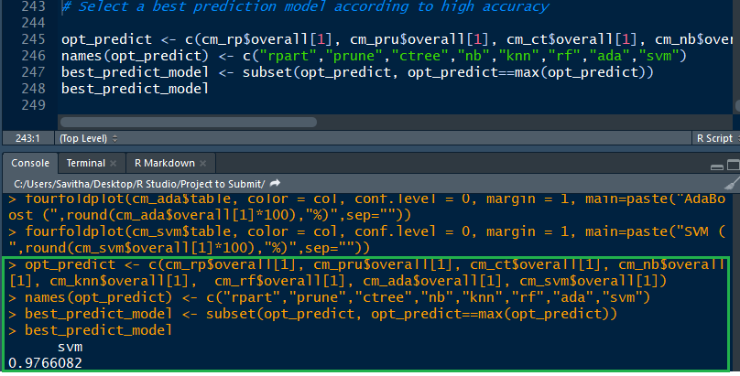
Select a best prediction model according to high accuracy - CODE

Slide 22
Conclusion
The performance of SVM shows the high level compare with other classifiers. Hence SVM shows the concrete results with Breast Cancer disease of patient records. Therefore SVM classifier is suggested for diagnosis of Breast Cancer disease based classification to get better results with accuracy, low error rate and performance.

